Slide 1

Be Disciplined
The Book of
Joel
Dr. Rick Griffith, Crossroads International Church Singapore
BibleStudyDownloads.org

Slide 2

Discipline
Notes:
Be disciplined or you will be disciplined.

Slide 3

Discipline
Notes:
This is true because any good leader disciplines those he cares about, and ultimately, God is the best disciplinarian.

Slide 4

Be disciplined or you will be disciplined.
Notes:
Which better describes your life now? Disciplining yourself or being disciplined by God?
If your experiences are sweet, thank God. Maybe you are disciplining yourself so God doesn’t have to get your attention. But if your experiences are sour, thank God also. Maybe this is just what you need for God to get your attention. Are you listening?

Slide 5
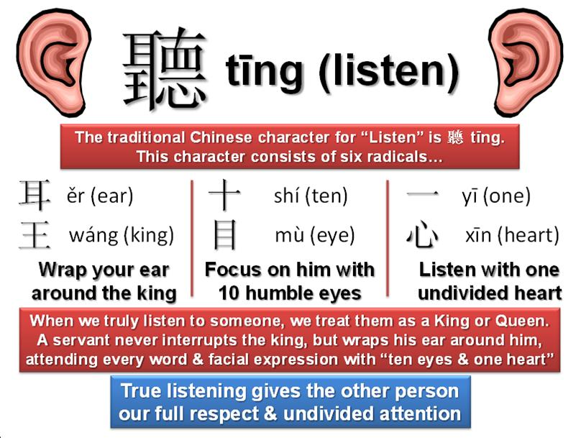
"Hear this, you leaders of the people.
Listen, all who live in the land"
(Joel 1:2a NLT).
The traditional Chinese character for "listen" consists of six radicals
When we truly listen to someone, we treat them as a king or queen. A servant never interrupts the king, but wraps his ear around him, attending every word & facial expression with "ten eyes & one heart"
True listening gives the other person our full respect and undivided attention.
Notes:
Are you really listening to what God is trying to tell you in your life?
Maybe he is trying to discipline you.

Slide 6
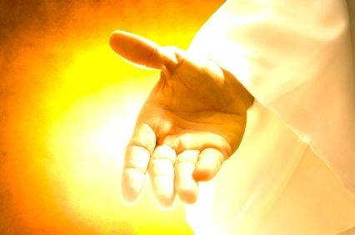
What should we do when we are disciplined?
Notes:
What should we do when we are disciplined?
Do you catch my double meaning here?

Slide 7

Background

Slide 8
Placing the Prophets
Placing the Prophets
342
Key Dates
931
Obadiah
722
Jonah
Amos
Hosea
Isaiah
Micah
Nahum
Zephaniah
Joel
586
Notes:
Although I cannot be dogmatic about dating Joel, the best option is that Joel prophesied after the Babylonians took 10,000 people of Judah captive in 597 BC.
However, he doesn’t mention the fall of Jerusalem in 586 BC. Therefore, he seemed to have ministered during this 11-year period just after a locust invasion and drought.

Slide 9

"They threw dice to decide which of my people would be their slaves.
They traded boys to obtain prostitutes and sold girls for enough wine to get drunk"
(Joel 3:3 NLT).
Notes:
Ar

Slide 10


The Sale of Judeans to the Greeks
"What do you have against me, Tyre and Sidon and you cities of Philistia? Are you trying to take revenge on me? If you are, then watch out! I will strike swiftly and pay you back for everything you have done. ⁵You have taken my silver and gold and all my precious treasures, and have carried them off to your pagan temples" (Joel 3:4-5 NLT).
219
Sidon
Tyre
Judah
Philistia
Notes:
Joel also mentions selling people to Greeks, which also happened only after about 600 BC when Greece became strong.

Slide 11
The Sale of Judeans to the Greeks
"You have sold the people of Judah and Jerusalem to the Greeks, so they could take them far from their homeland"
(Joel 3:6 NLT).
219
Greeks
Sidon
Tyre
Greeks were not a strong power until around 600-500 BC so Joel probably has a later date
Judah
Philistia

Slide 12
Jerusalem's Fall
Jerusalem's Fall
232
342
560
Key Dates
627
Jeremiah
605
Daniel
597
Ezekiel
586
538
Zephaniah
Joel
630
Lamentations
Habakkuk
590
606
Notes:
In our study of the Minor Prophets we are now near the time of the destruction of Jerusalem in 586 BC under Nebuchadnezzar. This was one of the two key times the city was destroyed as God’s discipline of his wayward people.

Slide 13
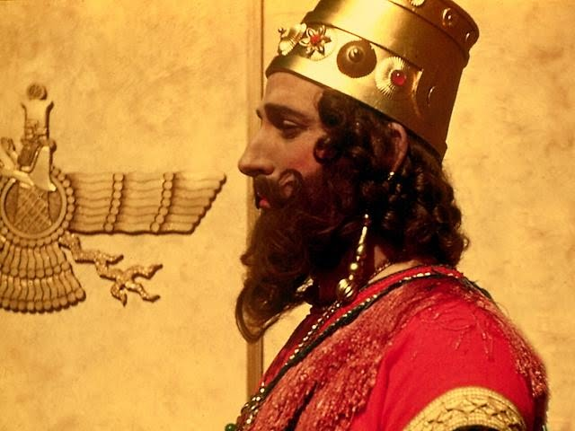
Joel Preached During King Nebuchadnezzar's Reign
Notes:
God's instrument of discipline was this pagan Babylonian king.

Slide 14

1. What to do now
2. How this will turn out
"TO DO" list for today
Notes:
Today we’ll see what to do about present difficulties, and then how these will all turn out in the end.

Slide 15
What should we do when we are disciplined?
Notes:
First, what should we do when we are disciplined?

Slide 16
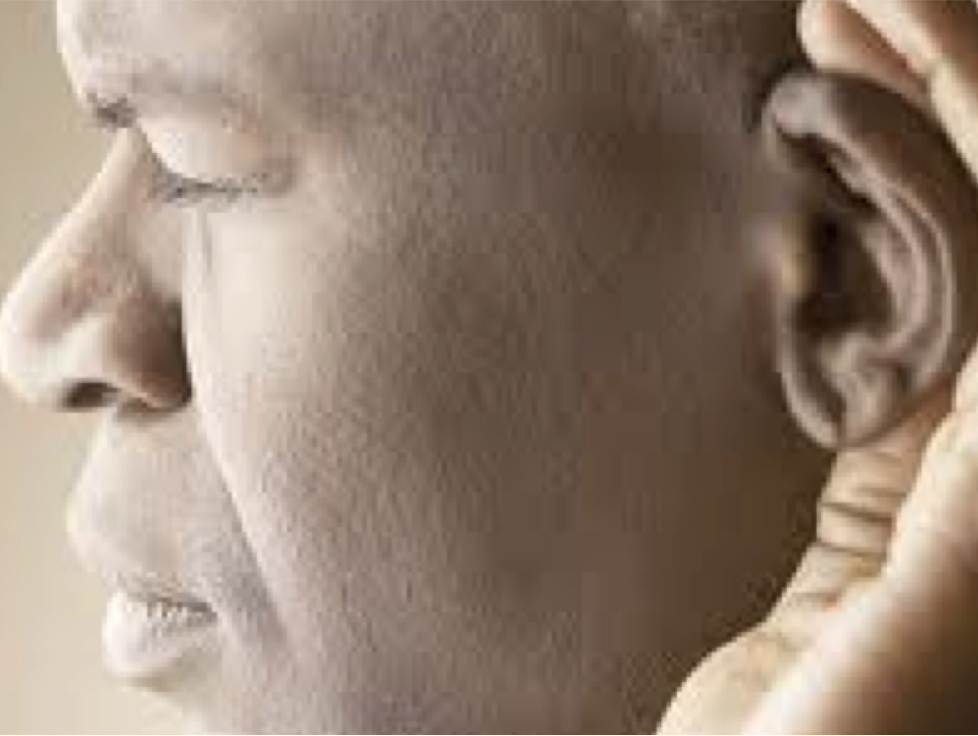
I. Discipline should bring repentance.
Joel 1:1–2:17
Notes:
Times of difficulty are great times to change our perspective.

Slide 17
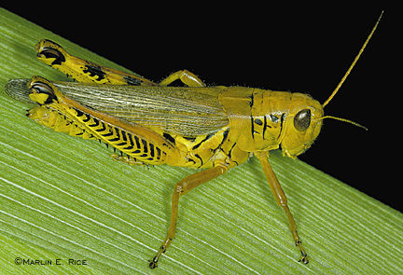
Joel
Devastation 1:1–2:17
Deliverance 2:18–3:21
Restoration 2:18-32
Blessing 3:17-21
Judgment 3:1-16
Disasters 1:1-20
Invasion 2:1-17
History
Prophecy
The Day of the LORD

Slide 18
Slides on
Joel 1

Slide 19
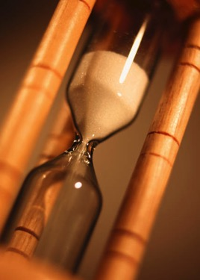
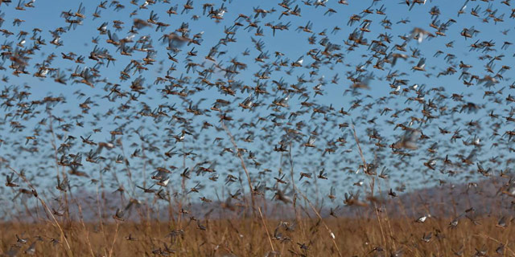
"Tell them about the locusts."
No king noted = no date noted
"The LORD gave this message to Joel son of Pethuel"
(Joel 1:1 NLT).
"OK."

Slide 20
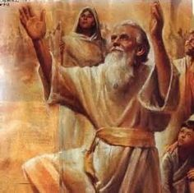
The Name "Joel" = LORD God
"Jo" = Jehovah = LORD
"El" = Elohim = God

Slide 21
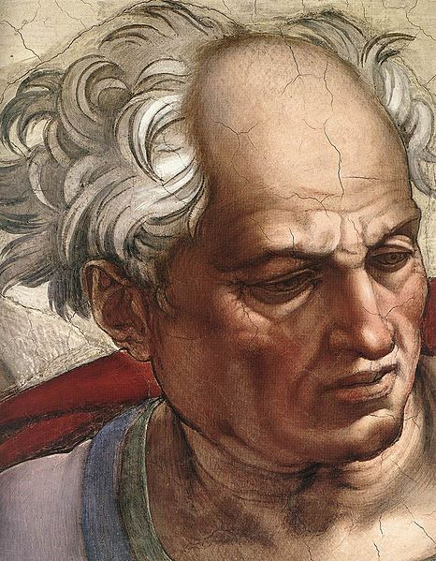
"Hear this, you leaders of the people.
Listen, all who live in the land. In all your history, has anything like this happened before?
³Tell your children about it in the years to come, and let your children tell their children.
Pass the story down from generation to generation"
(Joel 1:2-3 NLT).

Slide 22
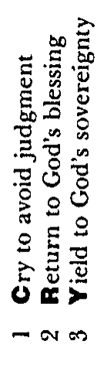
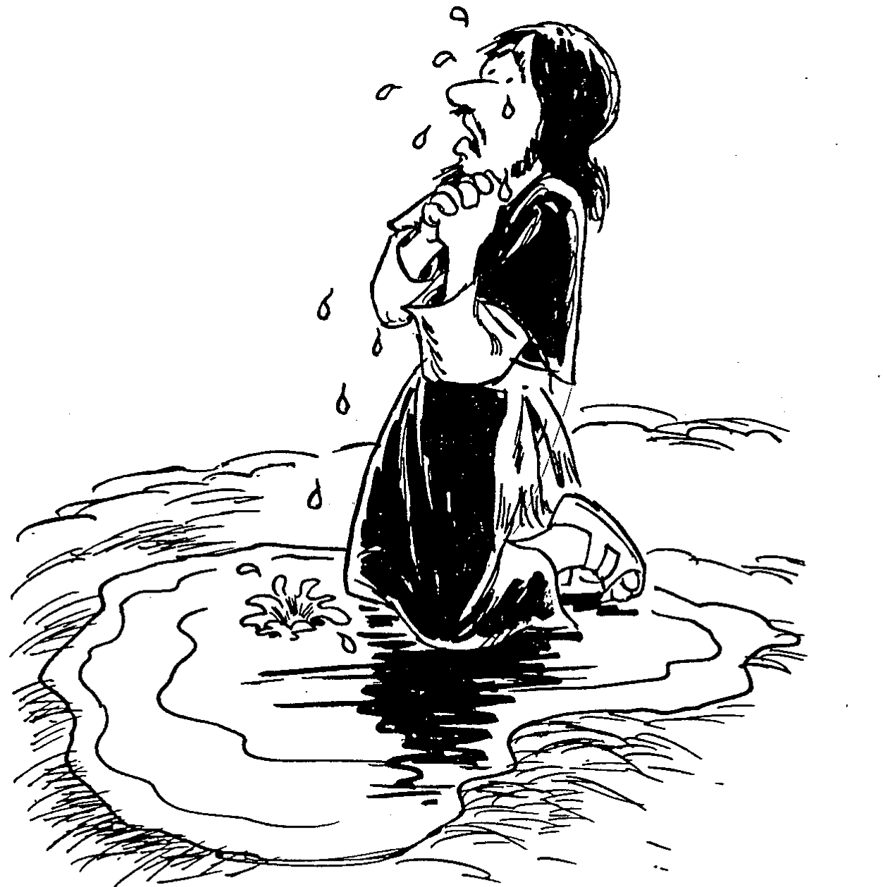
Barry Huddleston, The Acrostic Summarized Bible (Grand Rapids: Baker, 1992)
Joel
1 Cry to avoid judgment
2 Return to God's blessing
3 Yield to God's sovereignty

Slide 23
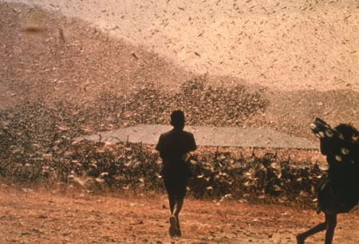
Date & Recipients
577
C. Date: late pre-exilic time period (between 597 and 586 BC).
D. Recipients: people in Judah due to many references to Zion and the Temple (1:9, 13-14; 2:15-17, 23, 32; 3:1, 5-6, 16-17, 20-21).

Slide 24
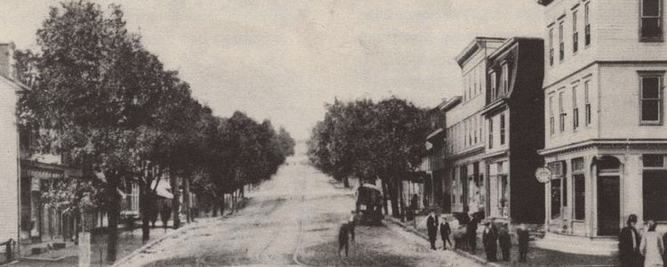
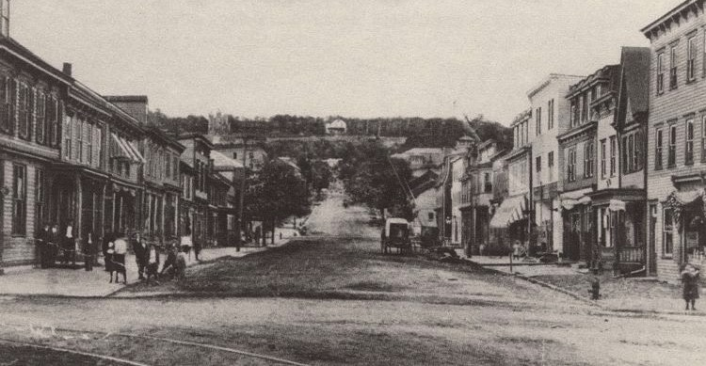
A Modern Locust Invasion
(Centralia, Pennsylvania, USA)
Before Locust Invasion
After Locust Invasion

Slide 25
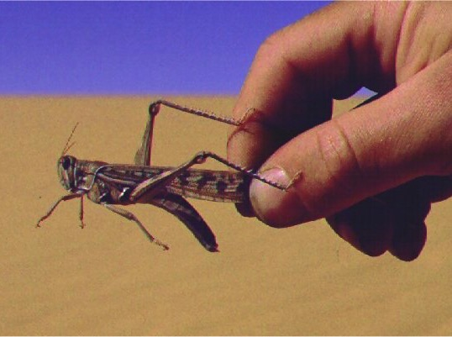
E. Occasion
577
A recent locust plague had invaded Judah

Slide 26
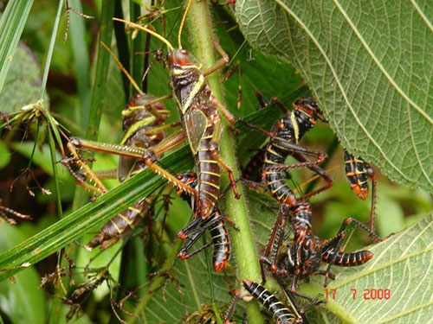
"After the cutting locusts finished eating the crops, the swarming locusts took what was left!
After them came the hopping locusts, and then the stripping locusts, too!"
(Joel 1:4 NLT).

Slide 27
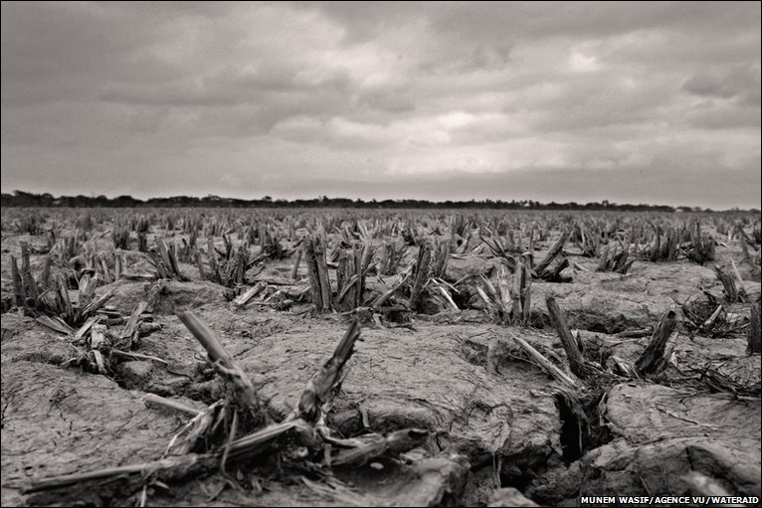
"Wake up, you drunkards, and weep!
Wail, all you wine-drinkers!
All the grapes are ruined, and all your sweet wine is gone"
(Joel 1:5 NLT).

Slide 28
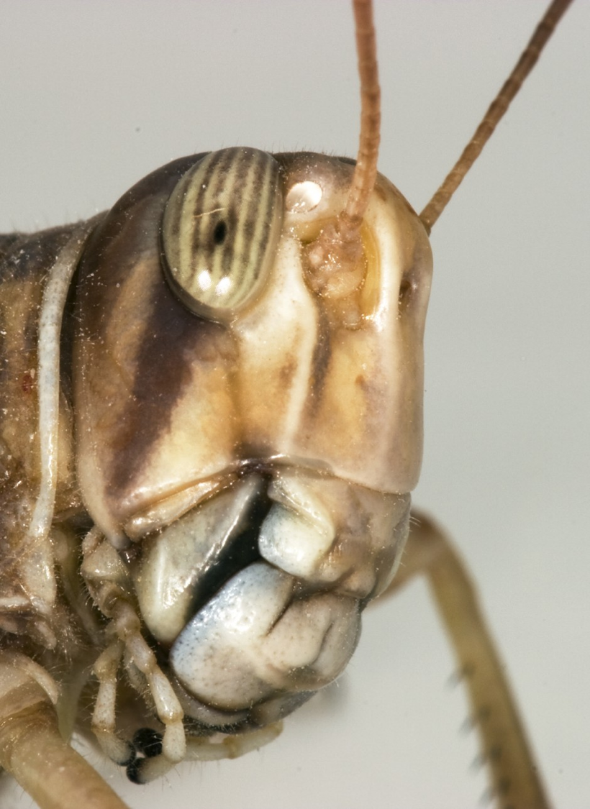
"A vast army of locusts has invaded my land, a terrible army too numerous to count.
Its teeth are like lions' teeth, its fangs like those of a lioness"
(Joel 1:6 NLT).

Slide 29
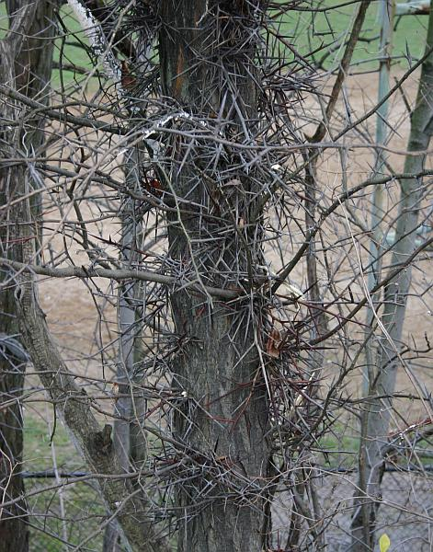
"It has destroyed my grapevines and ruined my fig trees, stripping their bark and destroying it, leaving the branches white and bare"
(Joel 1:7 NLT).

Slide 30
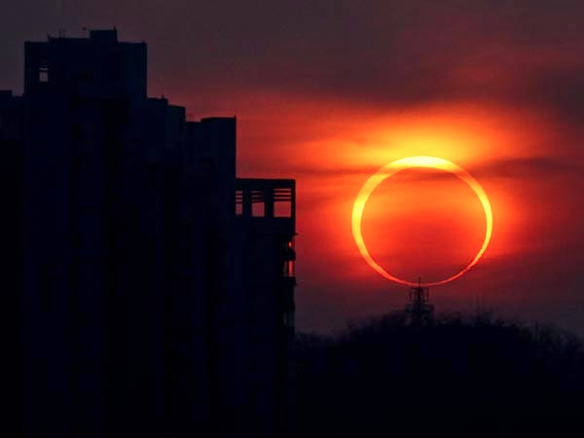
The Day of the LORD (Joel 1:15 NLT).
"The day of the LORD is near,
the day when destruction comes from the Almighty.
How terrible that day will be!"

Slide 31
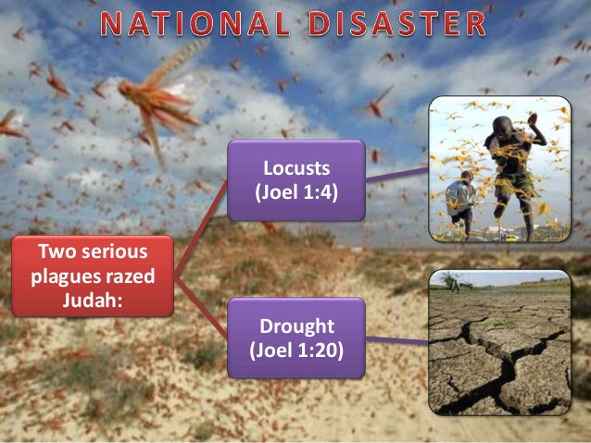
NATIONAL DISASTERS IN JOEL 1
Locusts
(Joel 1:4)
Two serious plagues razed Judah:
Drought
(Joel 1:20)

Slide 32
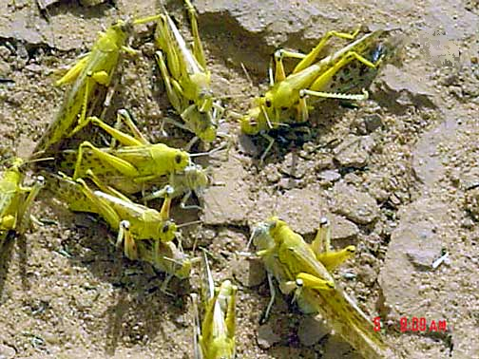
Mature adults copulating
Notes:
Mali: mature gregarious adults copulating (Tamesna, 11/03) http://www.fao.org/NEWS/GLOBAL/LOCUSTS/outbreakpix03.htm

Slide 33
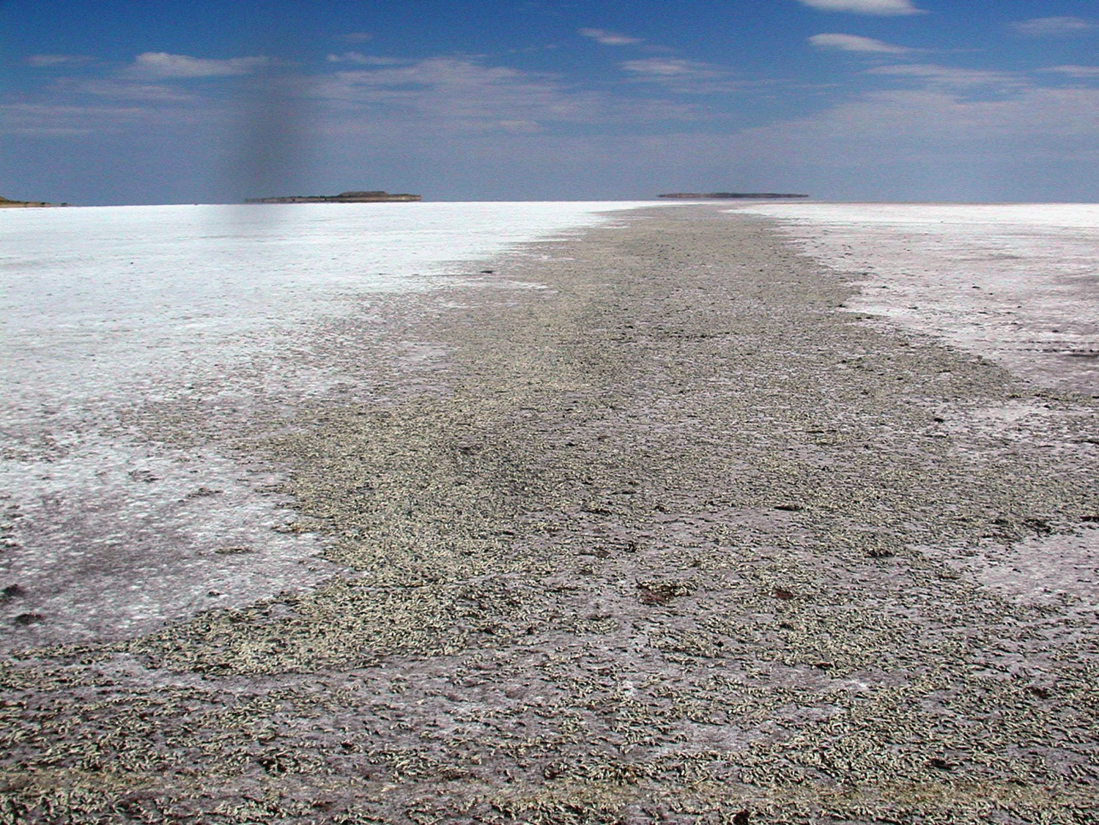
Locust Grave Yard, Salt Lake, Utah

Slide 34

Key Word
577
Locust

Slide 35
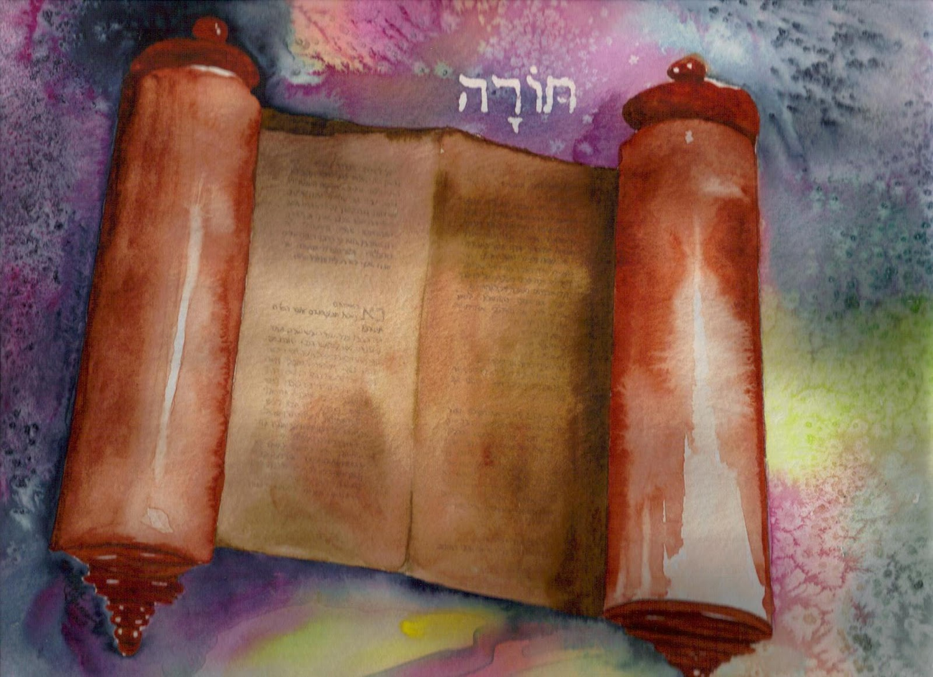
So what does the Torah say about locusts?

Slide 36
Blessings & Curses
577
154
220
Deut. 28
Your towns and your fields
will be blessed (3)
Your towns and your fields
will be cursed (16)
Your children and your crops
will be blessed (4)
Your children and your crops
will be cursed (17)
Your fruit baskets and bread-boards will be blessed (5)
Your fruit baskets and bread-boards will be cursed (18)
Wherever you go and whatever you do, you will be blessed (6)
Wherever you go and whatever you do, you will be cursed (19)
Your enemies will attack you from one direction, but they will scatter from you in seven! (7)
You will attack your enemies from one direction, but you will scatter from them in seven! (25)
You will lend to many nations, but you will never need to borrow from them (12)
They will lend to money to you, but you will not lend to them
(44)

Slide 37
Prophetic Curses
577
154
220
Why?
Exile
Deut. 28
Notes:
The curses of prophets like Joel are based on God's warnings to Israel hundreds of years earlier in Deut 28.

Slide 38
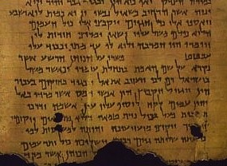
What Did a Locust Plague Mean?
577
NLT Deuteronomy 28:38 "You will plant much but harvest little, for locusts will eat your crops."

Slide 39
Slides on
Joel 2

Slide 40
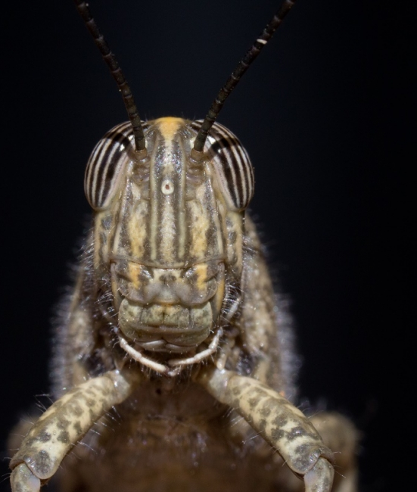
"Sound the alarm in Jerusalem!
Raise the battle cry on my holy mountain!
Let everyone tremble in fear because the day of the LORD is upon us" (Joel 2:1 NLT).

Slide 41
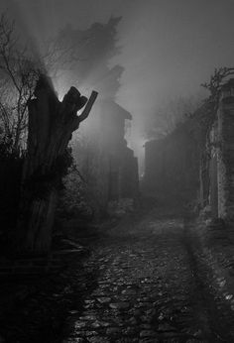
"[The day of the LORD]… is a day of darkness and gloom, a day of thick clouds and deep blackness.
Suddenly, like dawn spreading across the mountains, a great and mighty army appears.
Nothing like it has been seen before or will ever be seen again"
(Joel 2:2 NLT).

Slide 42
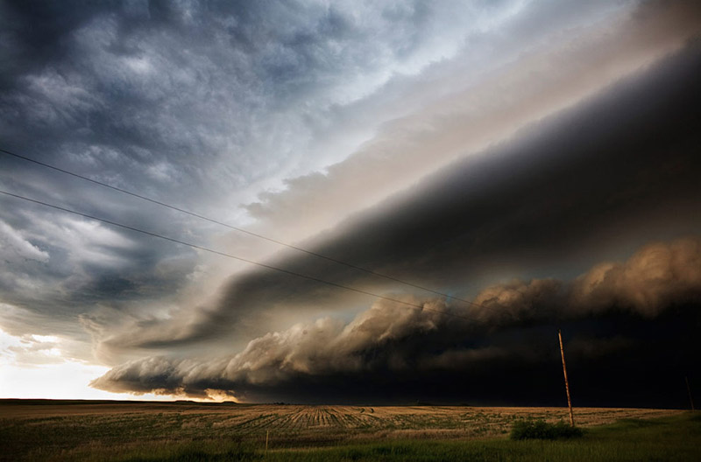
"Fire burns in front of them, and flames follow after them.
Ahead of them the land lies as beautiful as the Garden of Eden.
Behind them is nothing but desolation; not one thing escapes"
(Joel 2:3 NLT).

Slide 43
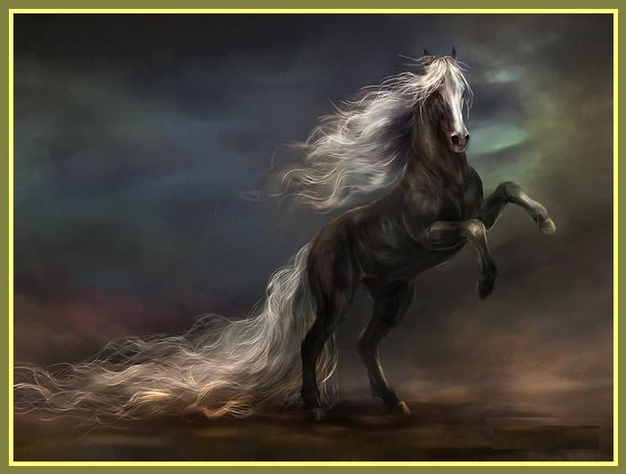
"They look like horses; they charge forward like war horses"
(Joel 2:4 NLT).

Slide 44
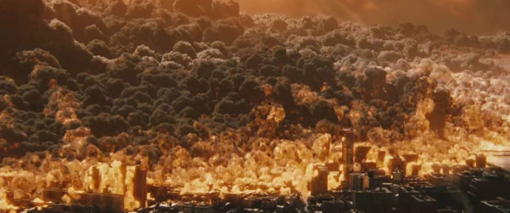
"Look at them as they leap along the mountaintops. Listen to the noise they make—like the rumbling of chariots, like the roar of fire sweeping across a field of stubble, or like a mighty army moving into battle"
(Joel 2:5 NLT).

Slide 45
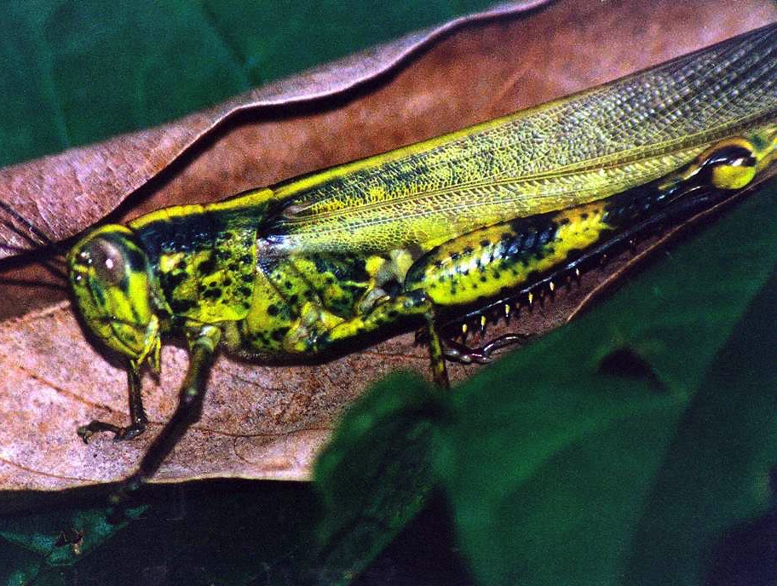
Key Verse
575
". . . The day of the LORD is great; it is dreadful. Who can endure it? 'Even now,' declares the LORD, 'return to me with all your heart, with fasting and weeping and mourning" (Joel 2:11b-12)

Slide 46
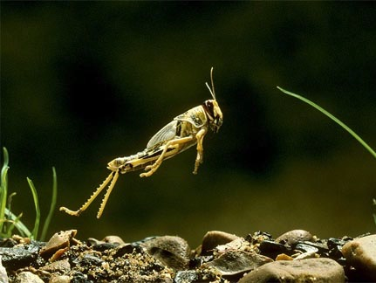
What are the "locusts" of Joel 2:1-11?
578
Both Locusts and Armies?
Supernatural Creatures?
Literal Locusts?
Figurative of One Army?
Figurative of Many Armies?
Notes:
Desert leaping locust

Slide 47
Joel
Devastation 1:1–2:17
Deliverance 2:18–3:21
Restoration 2:18-32
Blessing 3:17-21
Judgment 3:1-16
Disasters 1:1-20
Invasion 2:1-17
History
Prophecy
The Day of the LORD

Slide 48
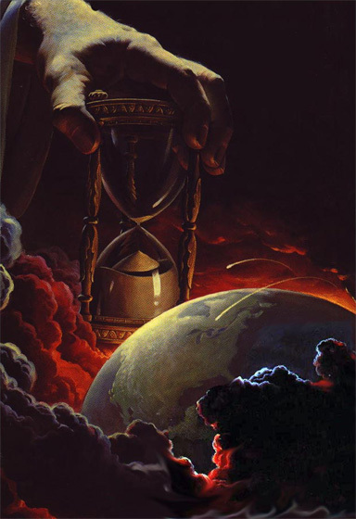
Why Future?
578
1. Imagery heightened: earthquake, signs in skies (Joel 2:10, 30-31; Matt. 24:29)

Slide 49
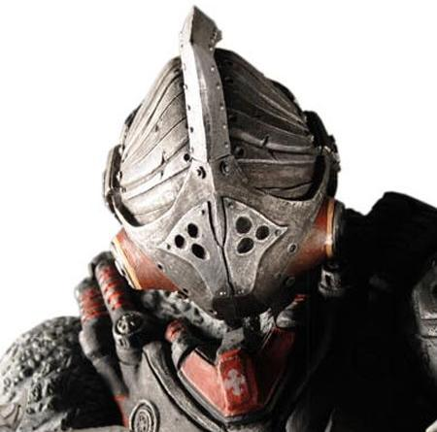
Why Future?
578
1. Imagery heightened: earthquake, signs in skies (Joel 2:10, 30-31; Matt. 24:29)
2. "Army" (Joel 2:2, 11)

Slide 50
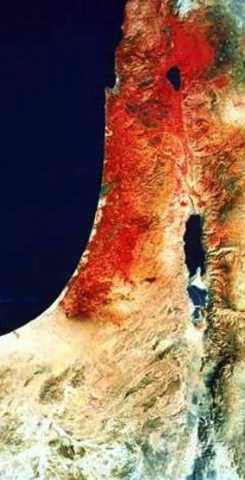
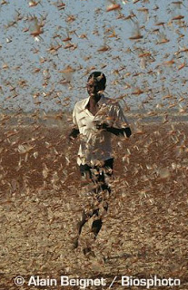
Why Future?
578
1. Imagery heightened: earthquake, signs in skies (Joel 2:10, 30-31; Matt. 24:29)
2. "Army" (Joel 2:2, 11)
3. Locusts never invade from the north like this "army"
(Joel 2:20)
4. The "northern one" (Joel 2:20) matches eschatological enemies invading from the north (Zech. 6:8, etc.)

Slide 51
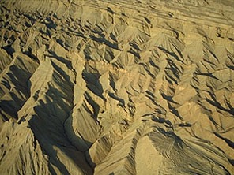
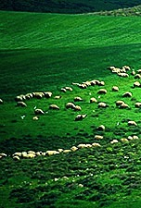
The Day of the LORD
638-639
Judgment
+
Blessing
Tribulation
Millennium
Rev. 6–19
Rev. 20
7 years
1000 years

Slide 52
A Dispensational Timeline
437
Great
White
Throne
(Rev. 20:11-14)
Rapture
(1 Thess. 4:13-18)
2nd Advent
(Zech. 14:3-5)
Day of the LORD
Church Age
Tribulation
(Zech. 14:1-2)
Millennium
(Zech. 14:6-21)
Gog & Magog
(Armageddon)
(Ezek. 38–39)
Gog and Magog
Revisited
(Rev. 20:7-10)
Notes:
52

Slide 53
What to do?
"'Even now,' declares the LORD,
'return to me with all your heart, with fasting and weeping and mourning.'
Rend your heart and not your garments. Return to the LORD your God, for he is gracious and compassionate, slow to anger and abounding in love, and he relents from sending calamity"
(Joel 2:12-13 NIV).

Slide 54
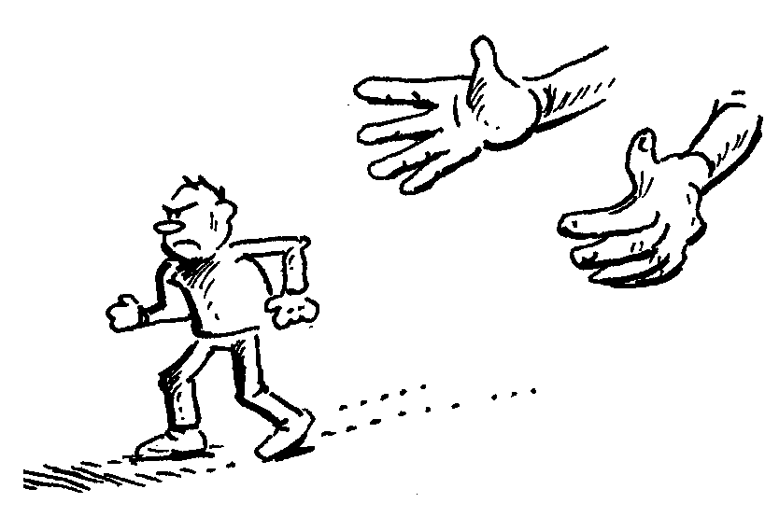
Do you reject God's discipline?
Notes:
God’s disciplining us should motivate us to seek the Lord.

Slide 55
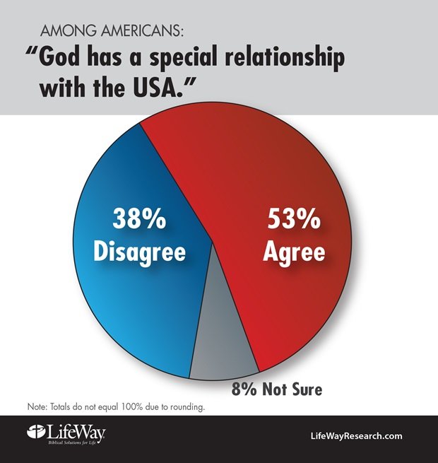
God & the USA
Notes:
The moral height of the USA was in the 1950s. The USA rebuilt its former enemies Japan and Germany, adopted “In God We Trust” as the national motto, and began to see many turn to Christ under Billy Graham as well send out missionaries to the nations.
Home > 2015 > July
Jul 3, 2015
God and Country: Americans' Views of God's 'Relationship' with the U.S
What do Americans think about the United States and God? Fascinating new data. |
Ed Stetzer
http://www.christianitytoday.com/edstetzer/2015/july/god-and-country-new-research-on-americans-views-of-country.html
Accessed 9 April 2017
Happy Fourth of July weekend folks, my American readers!
Two hundred thirty-nine years ago tomorrow, Congress adopted the Declaration of Independence, nearly a month before it would eventually be signed. I hope you're having a fun weekend, getting to enjoy some time with family and friends.
As I explained in a post last year:
Christians are, in a sense, dual citizens-- of the Kingdom and of the nation where they live. I live in a country that is not without fault, but I am proud to be a citizen of that nation. I teach my children to be proud of their nation-- not unaware of its challenges-- and patriotic citizens.
Just this week, LifeWay Research released some new data on how Americans view their country and how God relates with it. Here's an excerpt from our report:
In a nation founded on religious liberty, most Americans believe God has a special relationship with the United States, and they’re optimistic the best is yet to come.
Despite headlines lamenting the global decline of the United States since the Cold War, 54 percent of Americans believe the nation is on the upswing, according to a September survey by LifeWay Research. Only 4 in 10 think “America’s best days are behind us.”
And though the U.S. Constitution makes no mention of God, 53 percent of Americans say they believe God and the nation have a special relationship, a concept stretching back to Pilgrim days. Even a third of atheists, agnostics, and those with no religious preference believe America has a special relationship with God.
“‘God Bless America’ is more than a song or a prayer for many Americans,” said Ed Stetzer, executive director of LifeWay Research. “It is a belief that God has blessed America beyond what is typical for nations throughout history. I am sure that would spawn many theological conversations, but it’s important to note most Americans think God has a special relationship with their country.”
Christianity Today reported on the data, and added additional research, in their article, "God and America: It's Complicated," explaining, "A third of Americans say the United States is a Christian nation. But more than half say the country has a special relationship with the Almighty."
Christianity Today also included a link to my post providing cautions about combining patriotism and worship, where I explained the importance of patriotism (and not just in the U.S.), but also cautioned, "If your church service was driven more by America than by Jesus, I think you need a change."
Here are a couple of the graphs depicting the major findings:
One of the most interesting parts of the survey was the gender divide among the views:
Women are significantly more likely than men to believe God has a special relationship with the United States. While 49 percent of men have that view, the number rises to 58 percent for women.
LifeWay Research also found differences by age, race, geography, education, and religious preference.
Nearly two-thirds (63 percent) of Americans 45-54 years old think God has a special relationship with the United States, a belief shared by 48 percent of those 18-44.
Belief in a special relationship is also high among:
African-Americans, at 62 percent, compared to whites at 51 percent. Southerners, at 59 percent, compared to 49 percent of Midwesterners and 50 percent of Westerners. Those with a high school degree or less, at 66 percent. For those with some college, the rate drops to 51 percent. It drops further to 40 percent of those with a bachelor’s degree and 29 percent of those with a graduate degree. Evangelical Christians are the most likely to believe in a special relationship, with 67 percent agreeing. Among evangelicals 45 and older, the share soars to 71 percent.
“Americans, particularly those in more religious segments or geography, are most likely to believe in this special relationship,” Stetzer said. “But, considering the history of the nation, from Manifest Destiny to Ronald Reagan’s ‘City on a Hill’ speech, it’s not surprising this long-held theme continues today.”
A lot of this, of course, is rooted in our sense of American exceptionalism. Here's a bit on that from our report, including a thought from me:
Both ends of the political spectrum—from President Obama to the Republican Party platform—have touted American exceptionalism, the belief that the United States plays a unique role in human history. For some, the concept includes the idea of a special relationship with God, although beliefs about the nature of the relationship vary.
“Some Christians view America as an archetype of biblical Israel, chosen and uniquely blessed by God,” Stetzer said. “That’s why Christians sometimes speak of God ‘healing our land,’ when most theologians say this American ‘land’ is not in the same category as the ‘land’ of biblical Israel.”
What do you think? Is America exceptional? Does God have a special relationship with the United States? Comment below.
Click here to see the full research report.
Support our work. Subscribe to CT and get one year free.

Slide 56
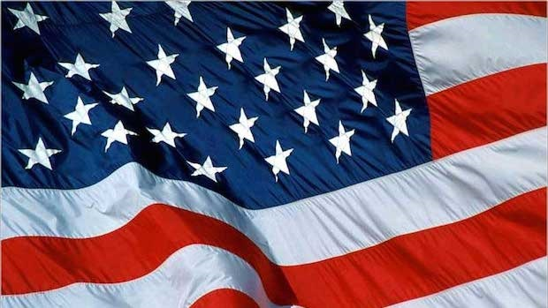
God's Discipline of the USA
Notes:
But the 1960s became a turning point: corporations wanting to prolong the Vietnam War to make more money off it, making it illegal to pray and read the Bible in schools, chaos in the many riots, and assassinations of key leaders like John F Kenney and Martin Luther King.
The last straw was America turning its back on Israel in recent years, even sponsoring a conference against Israel in January 2017 a week before the change of power in Washington.

Slide 57
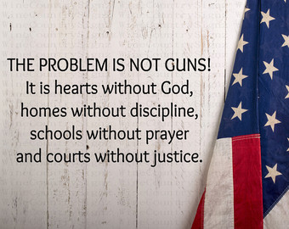
God's Discipline of the USA
THE PROBLEM IS NOT GUNS!
It is hearts without God, homes without discipline, schools without prayer, and courts without justice.
Notes:
As a result, the USA has been in horrible disarray: 78 million abortions, half of births to unwed mothers, 110 million people with STDs, disrespect around the world, involved in the longest war in US history in Afghanistan and Iraq, etc.
The USA has been under the disciplining hand of God in order that the country might turn back to him.

Slide 58
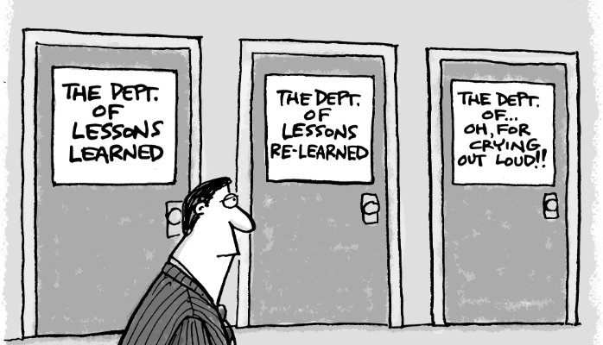
Discipline of Individuals
The Dept. of Lessons Learned
The Dept. of Lessons Re-Learned
The Dept. of…Oh, for Crying Out Loud!
Notes:
Some of us could share our stories.
Some have played with sin until we finally got disgusted with ourselves.
Others of us have become complacent so that we hardly give God a thought until Sunday.

Slide 59

I DON’T MAKE EXCUSES
I MAKE RESULTS
Notes:
The result? We lack love, joy, peace, patience, kindness, goodness, faithfulness, gentleness and self-control. How could we expect the fruit of the Spirit without being controlled by the Spirit?
God is calling us to repentance—a change of mind in whom we trust. He also wants to see in us the fruits of repentance—a change of actions that reveal we really did change our mind.

Slide 60
I. Discipline should bring repentance.
Joel 1:1–2:17
Notes:
Times of difficulty are great times to change our perspective.

Slide 61
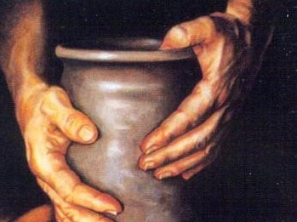
II. Repentance will bring restoration.
Joel 2:18–3:21
Notes:
Changing our minds about God leads to changing our future.

Slide 62
Joel
Devastation 1:1–2:17
Deliverance 2:18–3:21
Restoration 2:18-32
Blessing 3:17-21
Judgment 3:1-16
Disasters 1:1-20
Invasion 2:1-17
History
Prophecy
The Day of the LORD

Slide 63
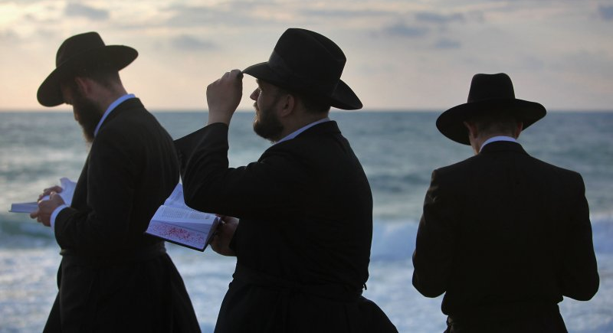
Israel’s repentance will bring forgiveness, deliverance and restoration (Joel 2:18–3:21).

Slide 64
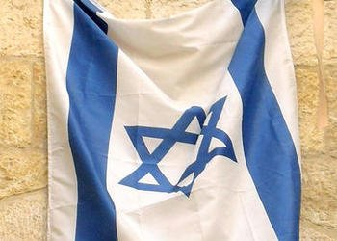
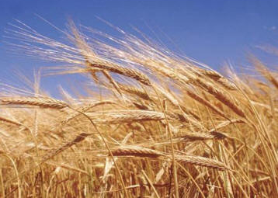
"Then the LORD will pity his people and jealously guard the honor of his land. ¹⁹The LORD will reply, 'Look! I am sending you grain and new wine and olive oil, enough to satisfy your needs. You will no longer be an object of mockery among the surrounding nations'"
(Joel 2:18-19 NLT).
Notes:
Israel’s repentance will bring forgiveness and blessing (2:18-27).

Slide 65
God's Future Protection of Israel
"'I will drive away these armies from the north. I will send them into the parched wastelands. Those in the front will be driven into the Dead Sea, and those at the rear into the Mediterranean.
The stench of their rotting bodies will rise over the land.'
Surely the Lord has done great things!"
(Joel 2:20 NLT).
219
The North
Israel

Slide 66
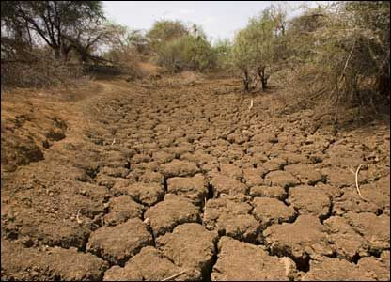
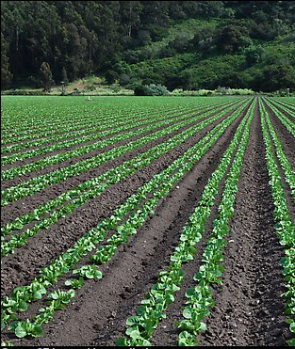
Land Contrasts in Joel 2:21-27
582
Mourned
"...The land mourns…"
(Joel 1:10 NAU).
Will be glad
"Do not fear, O land, rejoice and be glad,
For the LORD has done great things" (Joel 2:21 NAU).

Slide 67
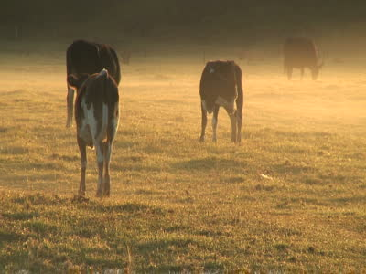

Animal Contrasts in Joel 2:21-27
582
Groaned, wandered, hungry
"How the animals moan with hunger! The herds of cattle wander about confused, because they have no pasture. The flocks of sheep and goats bleat in misery" (Joel 1:18 NLT).
Will not be afraid
"Don't be afraid, you animals of the field, for the wilderness pastures will soon be green"
(Joel 2:22a NLT).

Slide 68


Fields Contrasts in Joel 2:21-27
582
Barren and unproductive
"It has destroyed my grapevines and ruined my fig trees, stripping their bark and destroying it, leaving the branches white and bare" (Joel 1:7; cf. 1:10-12 NLT).
Will grow…fruitful and productive
"The trees will again be filled with fruit; fig trees and grapevines will be loaded down once more" (Joel 2:22b NLT).

Slide 69


Rain Contrasts in Joel 2:21-27
582
Drought (dryness caused fire)
"Even the wild animals cry out to you because the streams have dried up, and fire has consumed the wilderness pastures"
(Joel 1:20 NLT).
Will pour down in abundance
"Rejoice, you people of Jerusalem! Rejoice in the LORD your God! For the rain he sends demonstrates his faithfulness" (Joel 2:23 NLT).

Slide 70


Grain, Wine & Oil in Joel 2:21-27
582
Ruined and dried
"The fields are ruined, the land is stripped bare. The grain is destroyed, the grapes have shriveled, and the olive oil is gone"
(Joel 1:10 NLT).
Will be plentiful
"The threshing floors will again be piled high with grain, and the presses will overflow with new wine and olive oil"
(Joel 2:24 NLT).

Slide 71


Crop Contrasts in Joel 2:21-27
582
Damaged by locusts
"After the cutting locusts finished eating the crops, the swarming locusts took what was left! After them came the hopping locusts, and then the stripping locusts, too!" (Joel 1:4 NLT).
Productive
"The LORD says, 'I will give you back what you lost to the swarming locusts, the hopping locusts, the stripping locusts, and the cutting locusts. It was I who sent this great destroying army against you…"
(Joel 2:25-26 NLT).

Slide 72

Joel 2:28-29 in Acts 2:16-21
579
"This is that which was spoken by the prophet Joel…"
(Acts 2:16)
Notes:
In the day of the LORD, God will send the indwelling of the Spirit upon all Jews and celestial signs [when the Jewish nation repents at the return of Christ] (2:28-32).

Slide 73

Joel 2:28-29; Acts 2:17-18 NLT
"Then, after doing all those things, I will pour out my Spirit upon all people. Your sons and daughters will prophesy. Your old men will dream dreams, and your young men will see visions.
²⁹In those days I will pour out my Spirit even on servants—men and women alike."
579

Slide 74

Joel 2:28-29 in the NT (cf. Acts 2)
579
Some say this means "All the LORD's people would be prophets"—but is this what Joel said?
No, he said only many types of prophets would exist.

Slide 75

Joel 2:30-31; Acts 2:19-20 NLT
"And I will cause wonders in the heavens and on the earth—blood and fire and columns of smoke.
³¹The sun will become dark, and the moon will turn blood red before that great and terrible day of the LORD arrives."
579
Notes:
God notes these phenomena in the skies which were NOT at Pentecost in Acts 2. This clues us in that only the first part of the prophecy was fulfilled then in the outpouring of the Spirit. The rest will be fulfilled when Christ returns and the “terrible day of the LORD arrives.”

Slide 76
Joel 2:32; Acts 2:21 NLT
"But everyone who calls on the name of the LORD will be saved, for some on Mount Zion in Jerusalem will escape, just as the LORD has said. These will be among the survivors whom the LORD has called."
579

Slide 77
Slides on
Joel 3
Notes:
When God restores Israel as a nation He will judge the nations for abusing Judah (3:1-16).

Slide 78

"'At the time of those events,' says the LORD,
'when I restore the prosperity of Judah and Jerusalem,
²I will gather the armies of the world into the valley of Jehoshaphat'"
(Joel 3:1-2a NLT).

Slide 79



"There I will judge them for harming my people, my special possession, for scattering my people among the nations, and for dividing up my land"
(Joel 3:2b NLT).
Haifa
Tel Aviv
PALESTINE
I S R A E L
Jerusalem
PALESTINE
EGYPT
Negev
Desert
JORDAN
Notes:
This verse teaches that, at the return of Christ when the prosperity of Israel is restored and the nations judged (Joel 3:1-2a), Gentile armies will be judged for three crimes:
Harming Israel
Scattering Jews among the nations, and
Dividing Israel into various parts.
The 2020 peace accords between Israel and Bahrain and between Israel and UAE were accomplished on the condition that Israel keep the land divided among Israel and the Palestinians.

Slide 80


"Israel is the only place in the Middle East where Christians are free to practice their faith."
Benjamin Netanyahu

Slide 81

"IF THE ARABS PUT DOWN THEIR WEAPONS TODAY, THERE WOULD BE NO MORE VIOLENCE. IF THE JEWS PUT DOWN THEIR WEAPONS TODAY, THERE WOULD BE NO MORE ISRAEL."
BENJAMIN NETANYAHU

Slide 82
"They threw dice to decide which of my people would be their slaves.
They traded boys to obtain prostitutes and sold girls for enough wine to get drunk"
(Joel 3:3 NLT).

Slide 83
Tyre & Sidon to be Judged
"What do you have against me, Tyre and Sidon and you cities of Philistia? Are you trying to take revenge on me? If you are, then watch out! I will strike swiftly and pay you back for everything you have done. ⁵You have taken my silver and gold and all my precious treasures, and have carried them off to your pagan temples" (Joel 3:4-5 NLT).
219
Sidon
Tyre
Judah
Philistia

Slide 84
The Sale of Judeans to the Greeks
"You have sold the people of Judah and Jerusalem to the Greeks, so they could take them far from their homeland"
(Joel 3:6 NLT).
219
Greeks
Sidon
Tyre
Judah
Philistia

Slide 85
The Restoration of Judah
"But I will bring them back from all the places to which you sold them, and I will pay you back for everything you have done. ⁸I will sell your sons and daughters to the people of Judah, and they will sell them to the people of Arabia, a nation far away. I, the LORD, have spoken!"
(Joel 3:7-8 NLT).
219
Greeks
Sidon
Tyre
Judah
Arabia

Slide 86

"Say to the nations far and wide:
'Get ready for war!
Call out your best warriors.
Let all your fighting men advance for the attack.
¹⁰Hammer your plowshares into swords
and your pruning hooks into spears.
Train even your weaklings to be warriors.
¹¹Come quickly, all you nations everywhere.
Gather together in the valley.'
And now, O LORD, call out your warriors!"
(Joel 3:9-11 NLT).

Slide 87

"Let the nations be called to arms.
Let them march to the valley of Jehoshaphat.
There I, the LORD, will sit to pronounce judgment on them all.
¹³Swing the sickle, for the harvest is ripe.
Come, tread the grapes, for the winepress is full.
The storage vats are overflowing with the wickedness of these people"
(Joel 3:12-13 NLT).

Slide 88

"Thousands upon thousands are waiting in the valley of decision.
There the day of the LORD will soon arrive.
¹⁵The sun and moon will grow dark, and the stars will no longer shine"
(Joel 3:14-15 NLT).

Slide 89

"The LORD's voice will roar from Zion and thunder from Jerusalem, and the heavens and the earth will shake.
But the LORD will be a refuge for his people, a strong fortress for the people of Israel"
(Joel 3:16 NLT).

Slide 90

"Then you will know that I, the LORD your God, live in Zion, my holy mountain.
Jerusalem will be holy forever, and foreign armies will never conquer her again"
(Joel 3:17 NLT).

Slide 91

Israel & Egypt
"In that day the mountains will drip with sweet wine,
and the hills will flow with milk.
Water will fill the streambeds of Judah,
and a fountain will burst forth from the LORD's Temple,
watering the arid valley of acacias"
(Joel 3:18 NLT).

Slide 92

Israel's Neighbors
Israel
Egypt
"But Egypt will become a wasteland
and Edom will become a wilderness,
because they attacked the people of Judah
and killed innocent people in their land"
(Joel 3:19 NLT).
Edom

Slide 93

"But Judah will be filled with people forever, and Jerusalem will endure through all generations.
²¹I will pardon my people's crimes, which I have not yet pardoned; and I, the LORD, will make my home in Jerusalem with my people" (Joel 3:20-21 NLT).

Slide 94

Your trust in the Lord alone will bring his blessing

Slide 95
God's Restoration of the USA
Notes:
Repentance will bring restoration in a nation: Repentance in the USA is bringing about his blessing.
In April 2016 the most conservative Supreme Court justice died suddenly and his body was pronounced dead by a coroner who never actually saw the body, then the body was cremated within hours. This set the stage for a huge showdown whether the Court would shift to the Left for the next generation.

Slide 96

US Counties: Red Conservative + Blue Liberal
Notes:
The breaking point came last year when we actually had a candidate running for office under FBI investigation who destroyed 30,000 government documents.
God brought American Christians to a breaking point. Franklin Graham devoted the year to 50 prayer vigils—one on the steps of each capital of each state in the USA.
Election night showed a huge lead for Clinton until a massive prayer effort nationwide surged at about 8-9 PM, when it totally shifted.
The result? The past 8 years over 1000 liberal elected officials have been removed from office, culminating in the first Republican president, House and Senate in nearly 100 years. Only 17 of the 50 state governors are liberal now.

Slide 97

Neil Gorsuch
Notes:
The culmination came just two days ago (7 April 2017) when Neil Gorsuch was confirmed to the Court, restoring the 5-4 Constitutional edge. This was by far the most enduring act of President Trump will have in his 4-year or 8-year term(s) of office.

Slide 98

Our Vision
Love the Nations
Love the Church
Love God
Notes:
Repentance will bring restoration in a church: God wants our church to really trust him.
We still don’t see our need for him as we don’t see our need to pray.
We also need to be involved in his work: missions, teaching, accountability groups, finances, etc.

Slide 99
What should we do when we are disciplined?
Notes:
So back to our original question…

Slide 100

Main Idea of Joel
Discipline
Repentance
Restoration
Let discipline bring repentance and repentance bring restoration.
Notes:
God makes things difficult so we refocus on him and this change of mind renews our lives.

Slide 101
I. Discipline should bring repentance.
Joel 1:1–2:17
Notes:
Times of difficulty are great times to change our perspective.

Slide 102
II. Repentance will bring restoration.
Joel 2:18–3:21
Notes:
Changing our minds about God leads to changing our future.

Slide 103

Be disciplined or you will be disciplined.
Notes:
The book Celebration of Discipline shows the value of spiritual disciplines.

Slide 104

Accept God's discipline.
My son, do not despise the LORD’s discipline and do not resent his rebuke, because the LORD disciplines those he loves, as a father the son he delights in.
Proverbs 3:11-12

Slide 105

Questions to Consider
1. Do you need God to strip you of everything before you repent? (Huang Sabin)

Slide 106
Questions to Consider
2. Is God disciplining you to get your attention on him once again?

Slide 107
Questions to Consider
3. Have you considered fasting (1:14; 2:12) or do you think fasting isn’t for our modern age? Why wouldn’t it be?

Slide 108
Black

Slide 109


Bible Exposition at BibleStudyDownloads.org
Get this presentation for free!
Notes:
OT Survey (os)

